Slide 1
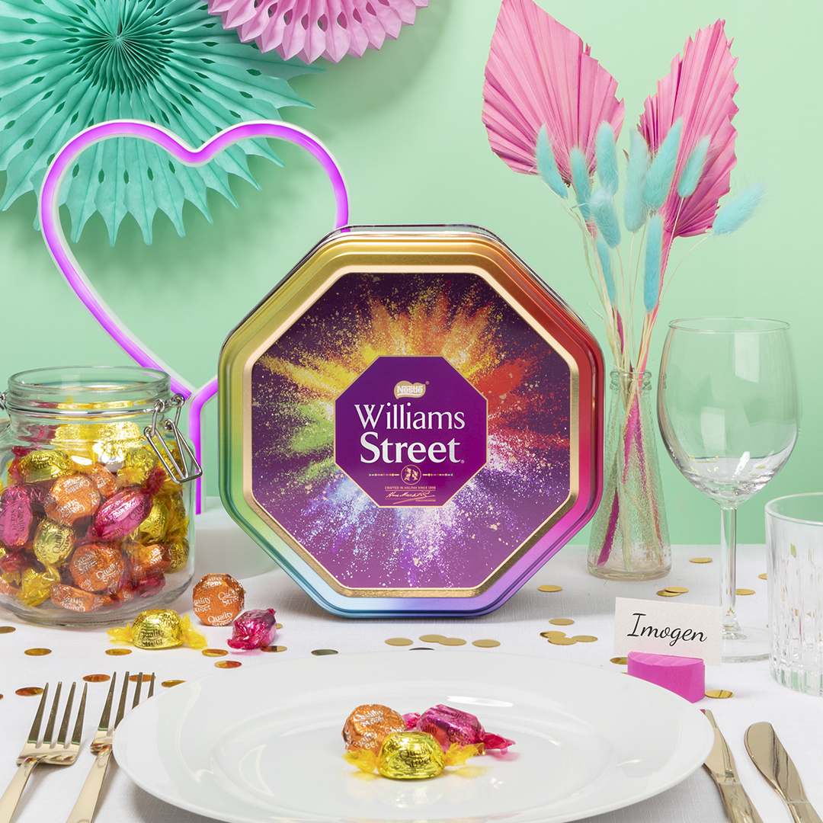
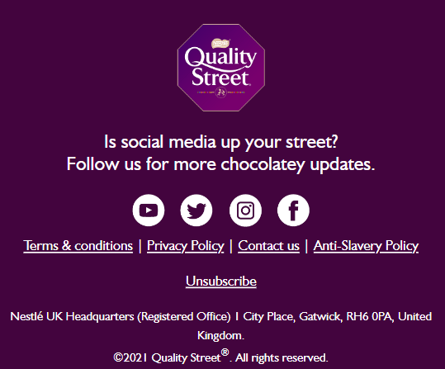
Something sweet for your sweetheart… | View In Browser
User Name Goes Here | Fallback
https://www.qualitystreet.co.uk/personalisation
20% OFF* CODE: VALENTINE
https://www.qualitystreet.co.uk/personalisation
PERSONALISE NOW
https://www.qualitystreet.co.uk/personalisation
23:59
DON’T FORGET TO ORDER IN TIME FOR VALENTINE’S DAY
Looking for the perfect personalised gift this Valentine’s Day? Surprise your loved one with a personalised tin of Quality Street®. Take 20% off* your next purchase of a personalised tin. USE CODE: VALENTINE
https://www.qualitystreet.co.uk/personalisation
REDEEM OFFER
https://www.qualitystreet.co.uk/personalisation
https://www.qualitystreet.co.uk/personalisation
WIN A LIMITED EDITION VALENTINE’S TIN
Do you have a chocolate lover in your life? Here’s a chance to make their Valentine’s extra special. To be in with a chance of winning a limited edition 1KG Valentine’s Quality Street Tin to gift to your other half, enter our website competition before 5th February.
https://www.qualitystreet.co.uk/valentines
https://www.qualitystreet.co.uk/valentines
ENTER NOW
*Terms & Conditions: 1. Voucher code entitles you to 20% off the total product value in your basket (excluding delivery costs). Subject to stock availability. 2. Account required. Max. one voucher code permitted per registered user. 3. Valid until 09.02.23. 4. To redeem, add the code into the ‘Discount and Gift’ field at checkout. 5. Voucher code can only be used once, has no cash value, is non-transferable and cannot be used in conjunction with any other offer. Promoter: Nestlé UK Ltd, Nestlé Confectionery (UK), York, YO91 1XY.
©2022 Quality Street®®. All rights reserved.

