Slide 1
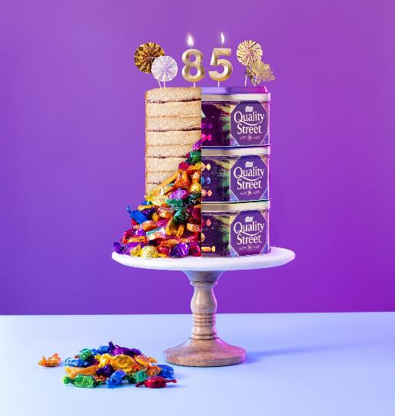
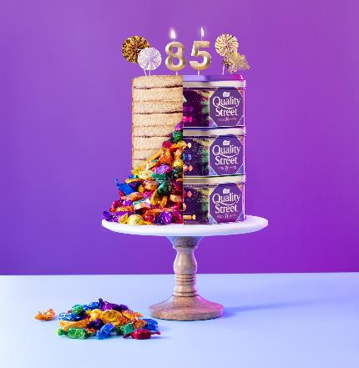
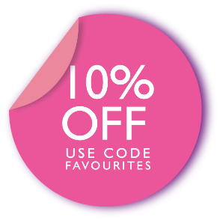
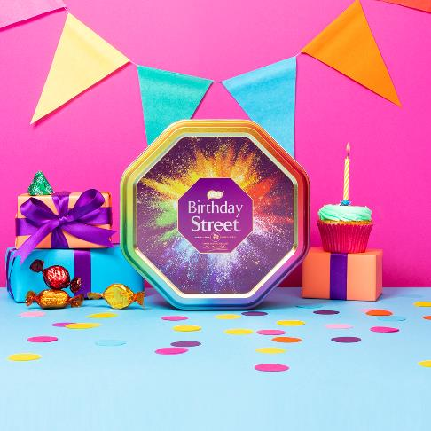
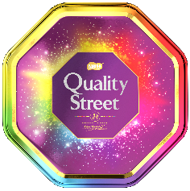
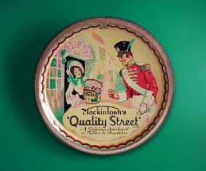
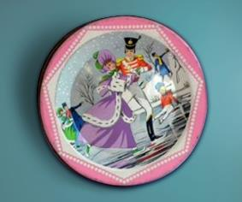
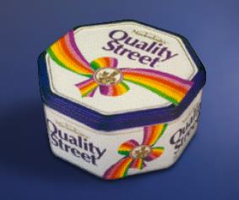
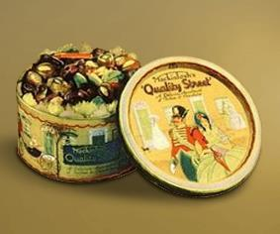
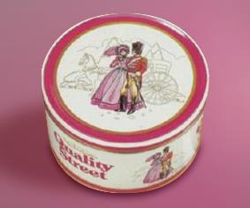
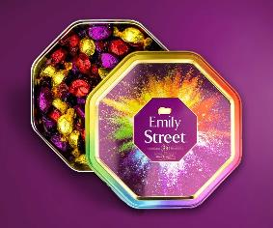
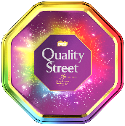
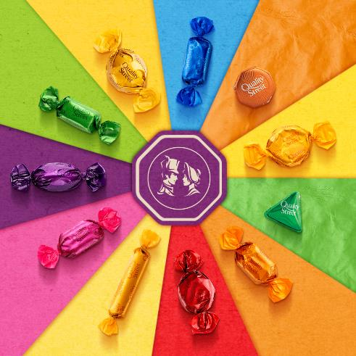
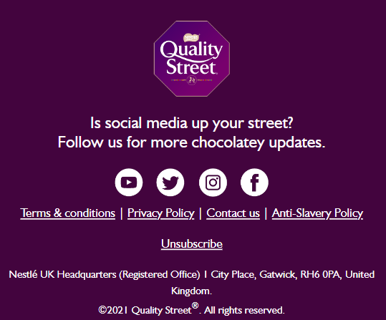
https://www.qualitystreet.co.uk/
*
CELEBRATE
https://www.qualitystreet.co.uk/personalisation
*NAME* CELEBRATE WITH US… IT’S OUR BIRTHDAY!
We’re turning 86 this year and our web shop is turning 2! So we thought we would share a gift with you… Our biggest fans! Take 10% off* your next purchase of a personalised tin. USE CODE: CELEBRATE
https://www.qualitystreet.co.uk/personalisation
REDEEM OFFER
https://www.qualitystreet.co.uk/personalisation
CLICK TO EXPLORE OUR TINS THROUGH THE AGES
1960’s In 1969, Mackintosh merges with Rowntree to form Rowntree Mackintosh.
1950’S The first Quality Street® TV advertisement aired in 1958 and there have been over 100 TV ads since then.
1990’s It was now that Quality Street® first introduced the octagonal tin replacing the previous round design.
1930’s The first tin of Quality Street® was produced in 1936 and sold for two shillings.
Present Day Quality Street® introduced our web shop in 2020 allowing customers to pick their favourites and personalise their tin.
1980’s Quality Street® focused more on ‘favourites’ both through products and press advertisements.
LEARN MORE
https://www.qualitystreet.co.uk/our-history
WE’RE MOVING TO PAPER WRAPPERS!
Our new positive change on packaging! This Christmas you will see some different wrappers in your Quality Street®® packs as we start to move to recyclable paper wrappers. By making this change we are aiming to remove over 2bn pieces of packaging by 2023.
https://www.qualitystreet.co.uk/sustainability
FIND OUT MORE
https://www.qualitystreet.co.uk/sustainability
https://www.qualitystreet.co.uk/sustainability
*Terms & Conditions: 1. Voucher code entitles you to 10% off the total product value in your basket (excluding delivery costs). Subject to stock availability. 2. Account required. Max. one voucher code permitted per registered user. 3. Valid until 31.12.22. 4. To redeem, add the code into the ‘Discount and Gift’ field at checkout. 5. Voucher code can only be used once, has no cash value, is non-transferable and cannot be used in conjunction with any other offer. Promoter: Nestlé UK Ltd, Nestlé Confectionery (UK), York, YO91 1XY.
©2022 Quality Street®®. All rights reserved.

